Slide 1

HomeBase
Connecting lone soldiers to support, information, and home.
Hen Golyan

Slide 2

About Us

Slide 3
Today’s Solutions
 | Language support | Information Hub | Personalization | Location finder | Focus on target audience | Community connection
Military OneSource | X | V | V | X | X | X
The Military App | X | V | V | X | V | V
Hero Care | X | X | X | X | X | X
HomeBase | V | V | V | V | V | V

Slide 4







What Makes HomeBase Unique?
Multiple Language Support
Organization-Based Information
Personal User Preferences
Real-Time Place Suggestions
Focused on Lone Soldiers
Community Suggestions & Creation

Slide 5
Interaction Approach
User Input
Touch • Search • Preferences
HomeBase uses a Graphical User Interface (GUI) to provide a simple and visual user experience.
The interface includes screens, buttons, menus, icons, maps, and personalized content, making information and support easy to access.
Location-based features help users find nearby organizations, communities, and support services.
HomeBase GUI Screens • Buttons • Menus • Maps
Personalized Output Rights • Communities • Support

Slide 6



Our Users
Jeremy
Lone Soldier from America
Nina
Lone Soldier from France
Eitan
Israeli Lone Soldier
Decided to volunteer for the IDF after the death of his grandmother, a Holocaust survivor. He has no family in Israel and does not speak the language, which makes it difficult for him to ask for help.
Always dreamed of serving in the IDF, inspired by her Israeli parents who also served. When she arrived in Israel, she struggled to meet people and adapt to the language and cultural differences.
An only child who lost his parents in a car accident at age 15. Although he has many friends, they cannot help him understand his rights as a lone soldier

Slide 7
Our Users
Jeremy
Lone Soldier from America
Nina
Lone Soldier from France
Eitan
Israeli Lone Soldier
Through HomeBase, he can find relevant WhatsApp groups, support communities, and answers to everyday questions.
HomeBase helps her find nearby places, communities, clubs, and WhatsApp groups for lone soldiers like her.
HomeBase gives him organized information in his native language, along with a community where he can ask questions and get support.

Slide 8
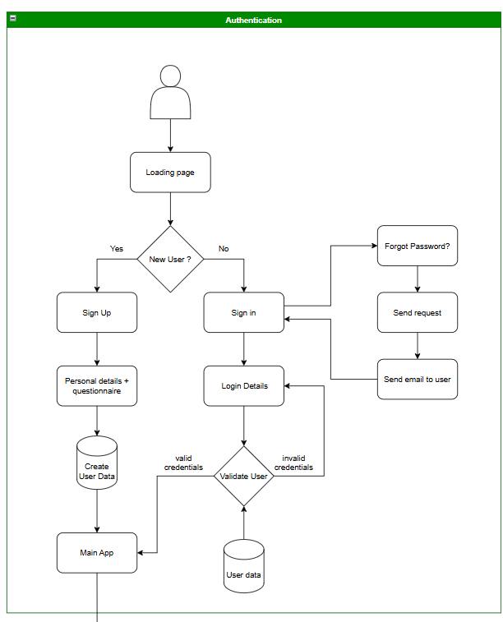
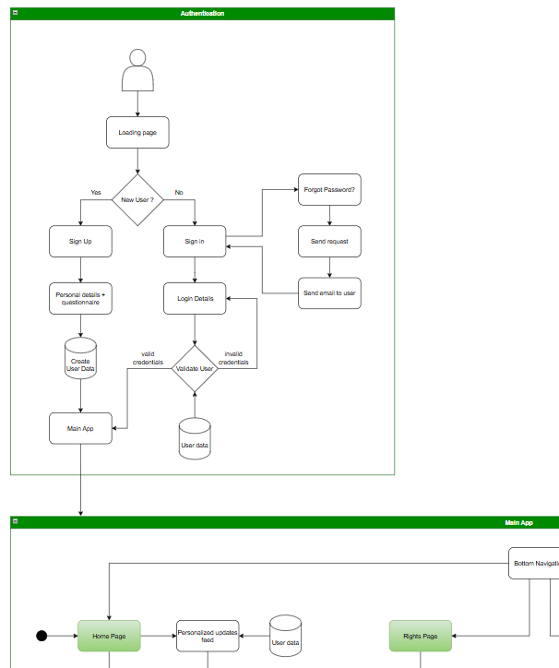
Our Architecture

Slide 9
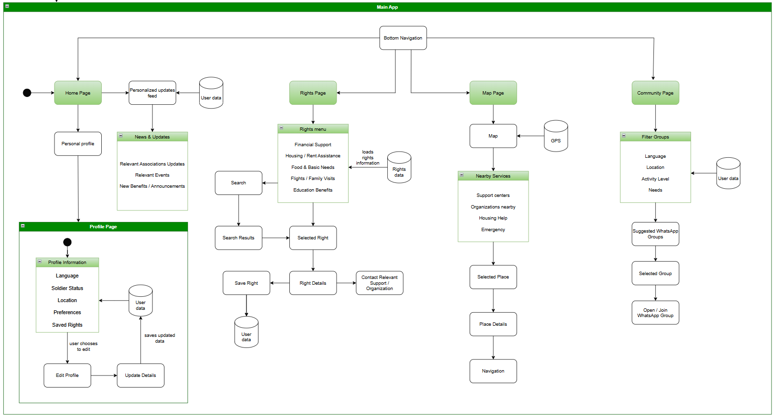
Our Architecture

Slide 10
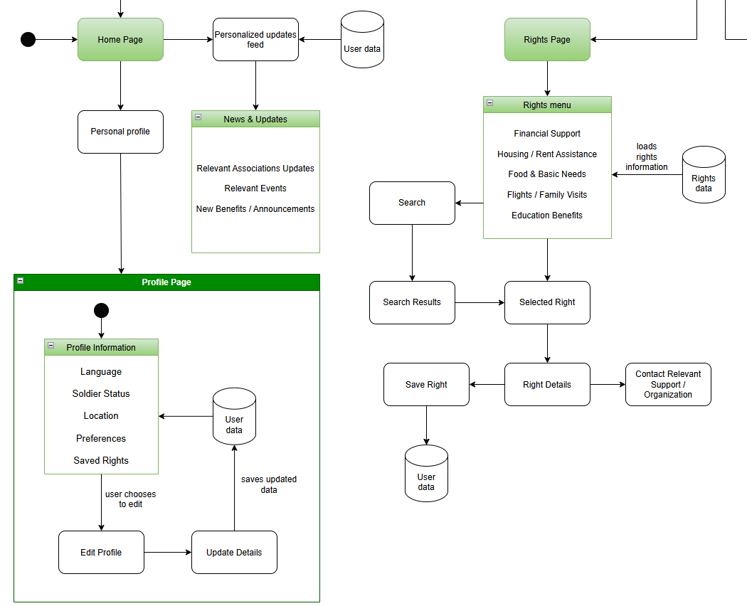
Our Architecture

Slide 11
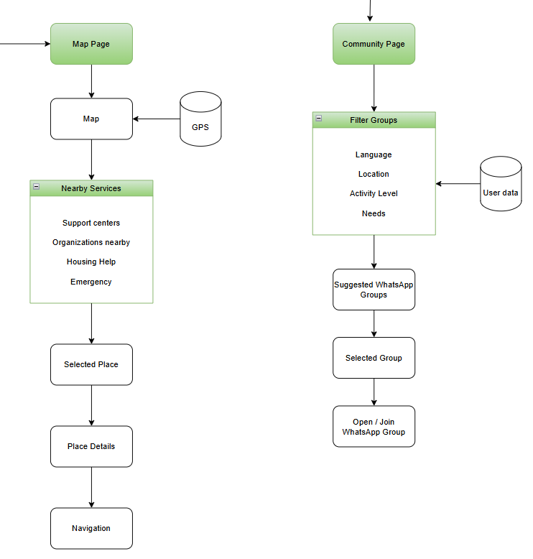
Our Architecture

Slide 12
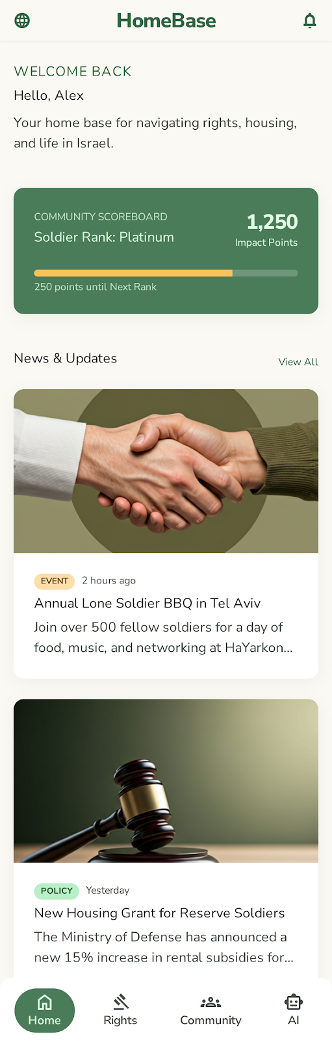

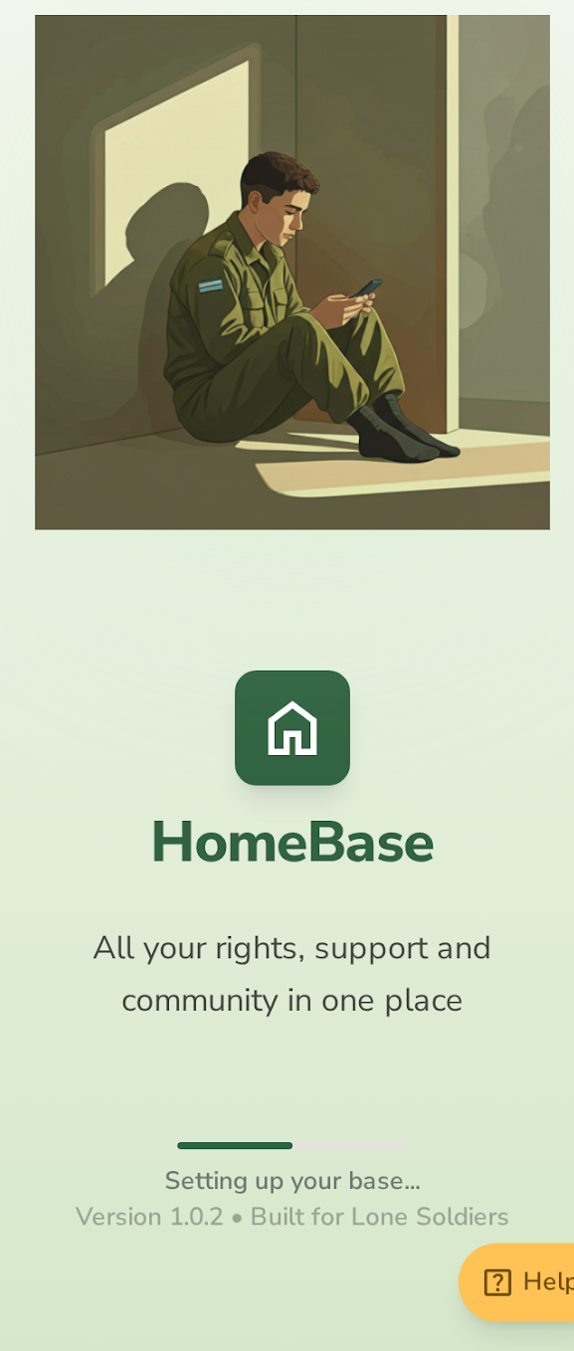
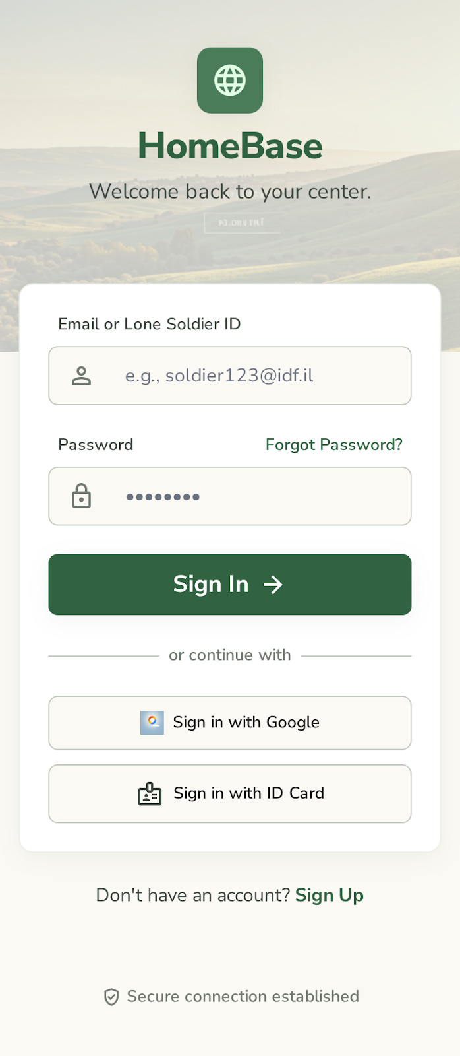
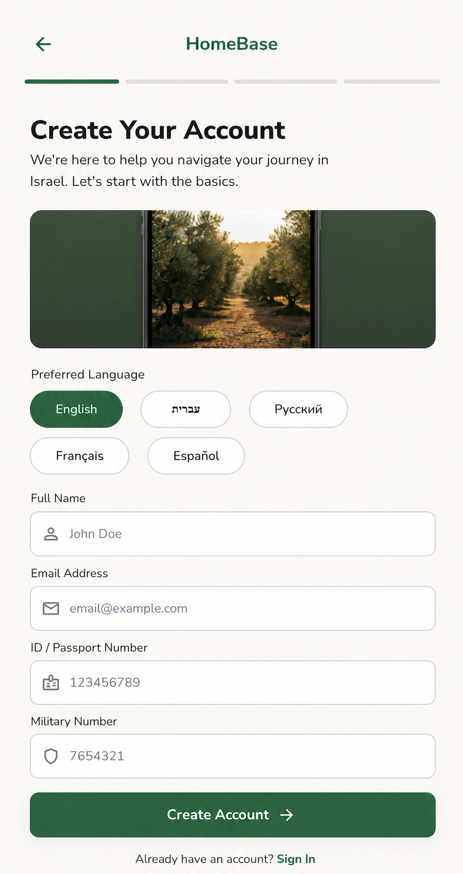


App Screen Design
Home Page
Loading Page
Sign in Page
Sign up Page

Slide 13
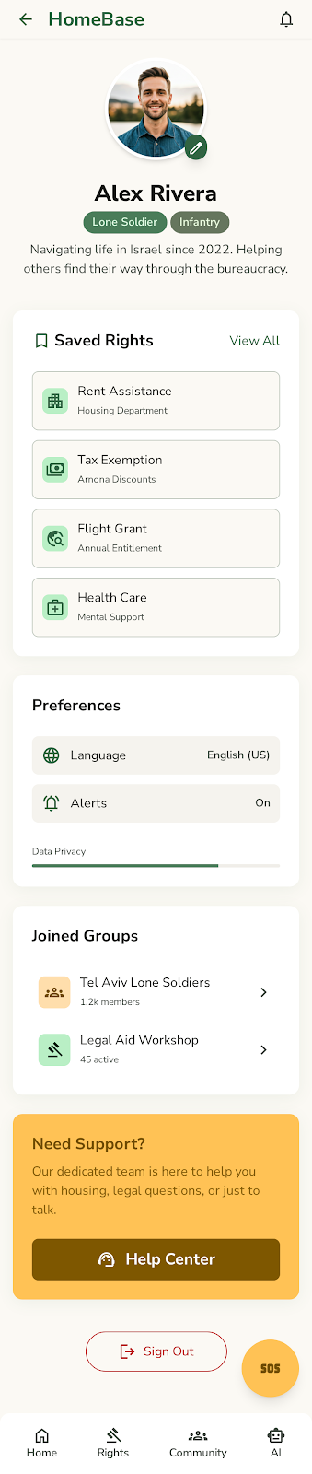
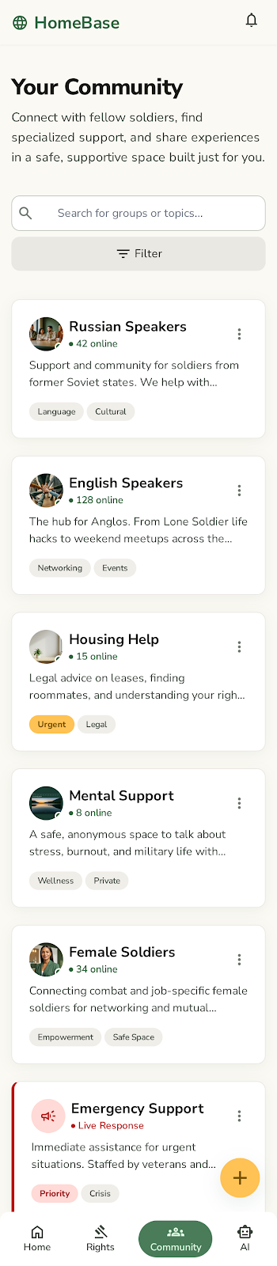
App Screen Design
Profile Page
Home Page
Community Page

Slide 14
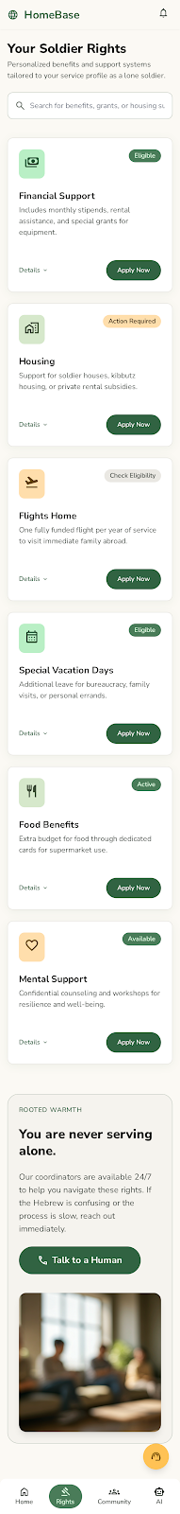
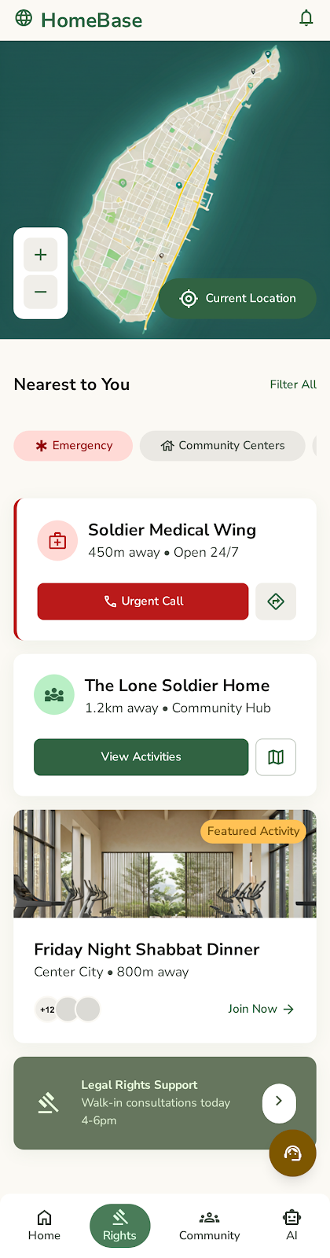

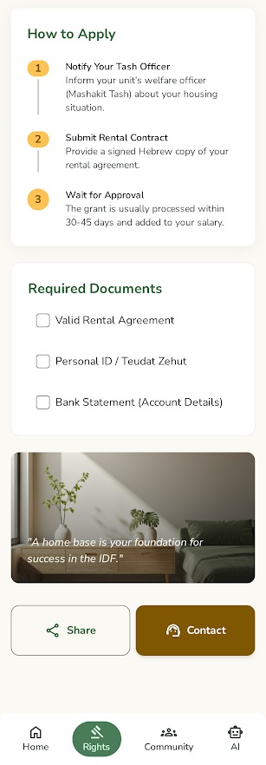
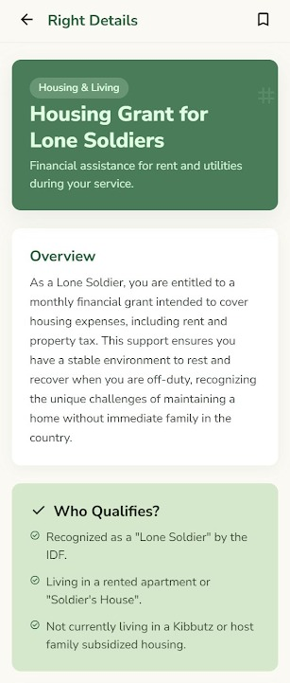

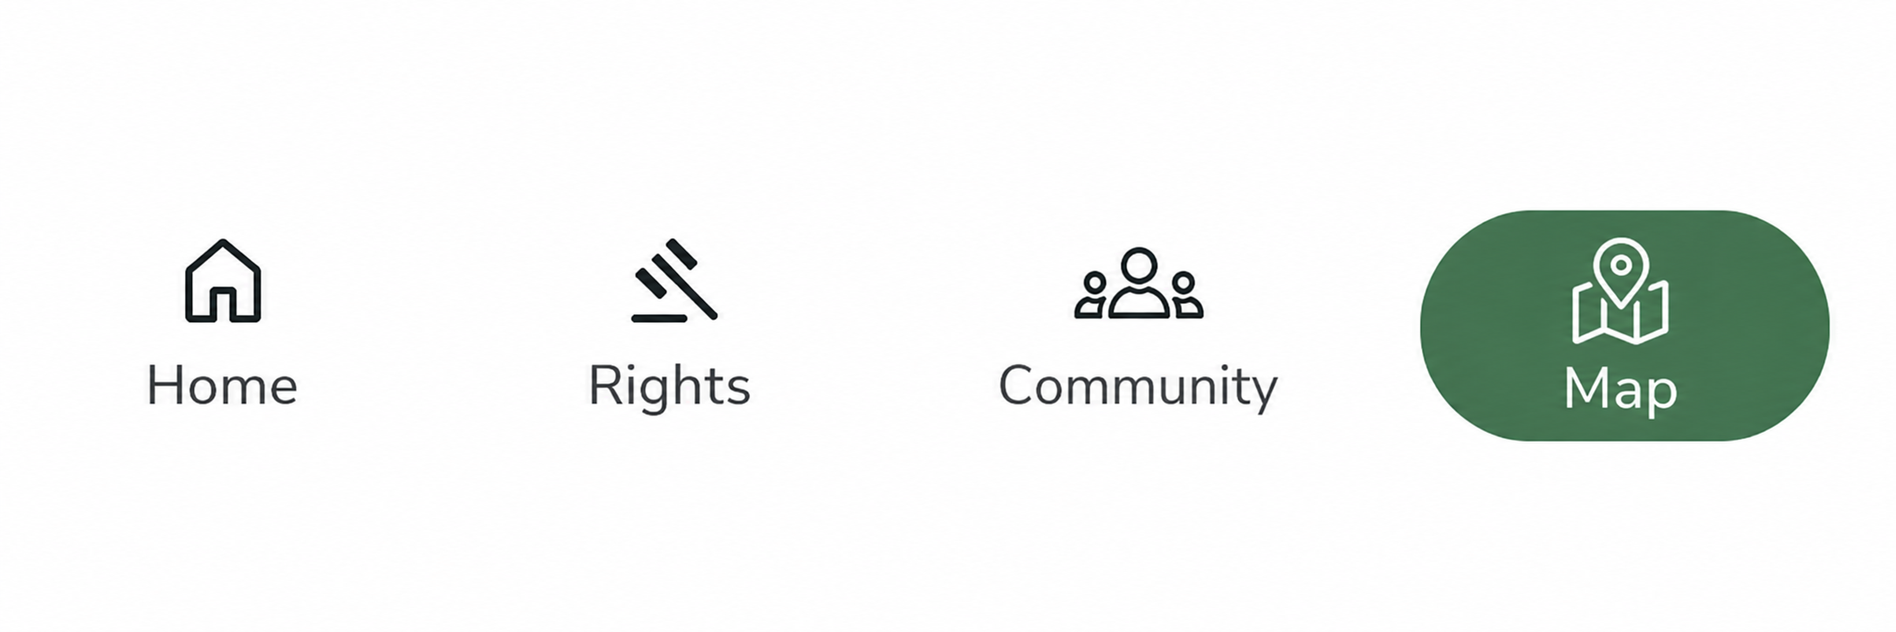
App Screen Design
Map Page
Rights Page

Slide 15


